Slide 1

RadiationTherapy in Neuroblastoma
Christian Carrie
Centre Leon Berard - Lyon
France

Slide 2
  5-10% of childhood tumours
  but 15% of death

Slide 3
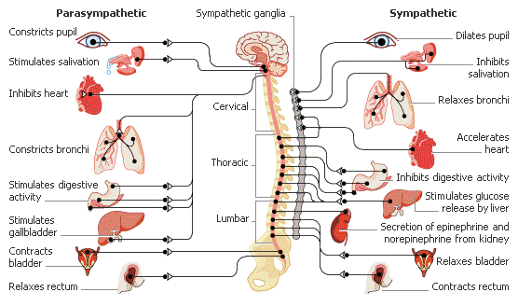
“Neuroblastoma is a malignant (cancerous) tumor that develops from sympathetic nerve tissue.”

Slide 4
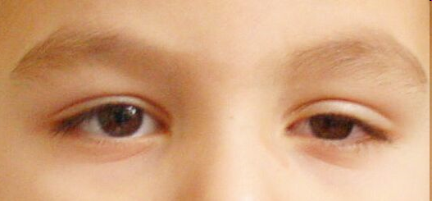
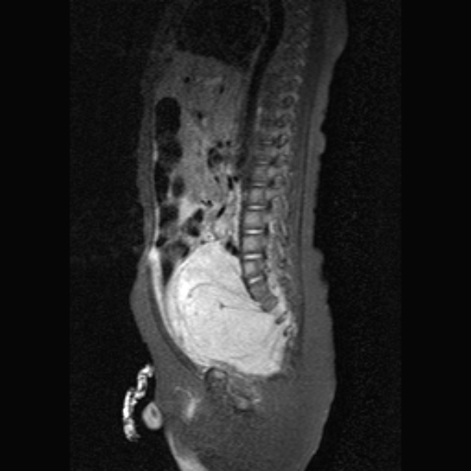
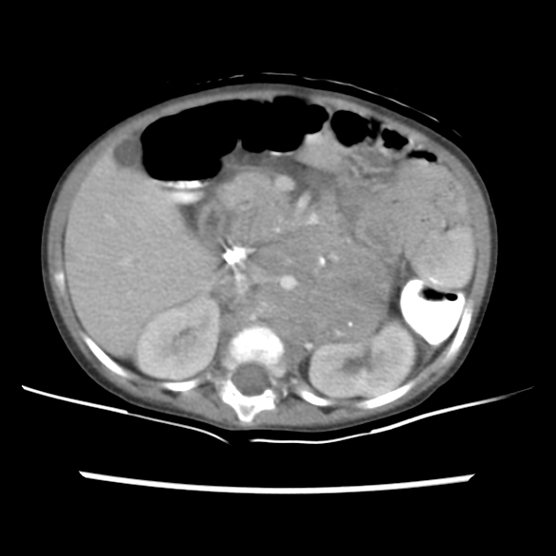
5 % cervical
!!! Claude Bernard Horner
30 % thoracic
Spinal cord compression
60 % abdominal
(rétroperitonéal)
Blood pressure
5 % pelvic
Sphincter dysfunction

Slide 5
Clinical features
• Most common non-CNS pediatric solid tumor: 10% of all pediatric neoplasms (30% of infantile tumors)
• Most common sites of origin:
Adrenals (48%) : often painless abdominal mass)• Extra-adrenal retroperitoneum (25%)
Chest (16%)
• Paraneoplastic syndromes
Opsoclonus/myoclonus (~25%)
• Hypertension 10% due to high VMA/cathecholamines
• Imaging:
Extrarenal, fine calcifications (85%)
No definite capsule, encases vessels, intraspinal extension
Mets: Bone/marrow, lymph nodes, liver, skin

Slide 9
Stadification
Neuroblastoma Staging - INSS
International Neuroblastoma Staging System (INSS)
1 Localized tumor with complete gross resection
No regional lymph node involvement
2 Localized tumor with incomplete gross resection without
  Ipsilateral lymph node involvement (2A) or with Ipsilateral
lymph node involvement (2B)
3 Tumor crossing midline and/or contralateral lymph node
involvement
4 Tumor with distant metastases
4s Patient <18 months with localized tumor and metastases
confined to liver, skin and/or marrow : Pepper syndrome
Ref : Brodeur GM, et al. JCO 1988 & 1993

Slide 11
(life threatening symptoms)

Slide 13
Contemporaneous Evolution of Systemic Therapy in High Risk Neuroblastoma
HD chemo +abmt
Differentiation Therapy
-Cis-retinoic acidB
Immunotherapy
-Anti-GD2, IL2, GMCSFC
Target Therapies
-CrizotinibD,F
Epigenetic Modifiers
-HDACH, ATR inhibitorI
Targeted
Immunotherapy
-Antigen directed CARTE,G
Intensified TransplantF

Slide 14
Role of RT : evolution of concept
TBI+
primary Site
PrimarySite +
Metastatic
Site
1primary Site +
Metastatic
Site RT
+
I131 MIBG

Slide 15
Radiotherapy and local control
 | No rt | rt
Rosen 84 | 81 | 32
Castelberry 94 | 54 | 21
West 93 | 33 | 8
Mattay 93 | 31 | 26

Slide 16
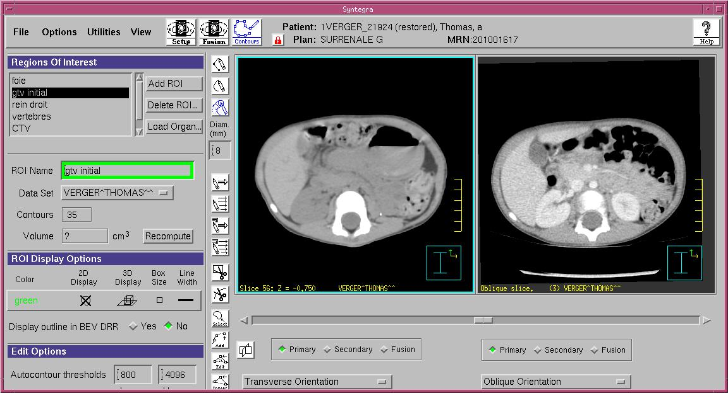
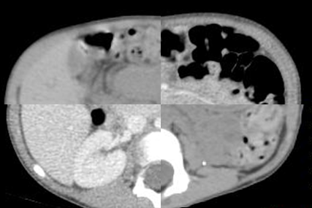
Target volume = preoperative volume coregistration with preoperative CT or MRI
CoRegistered CT
Use coregistration with great caution
CT or MRI are not performed in treatment position
Organs have moved
Priority to
Radiologist report/discussion
Surgeon’s report/discussion+ Clips
Anatomopathology report

Slide 17
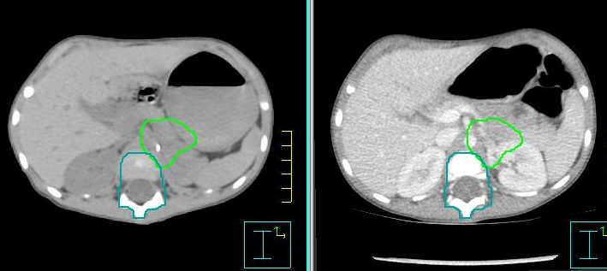
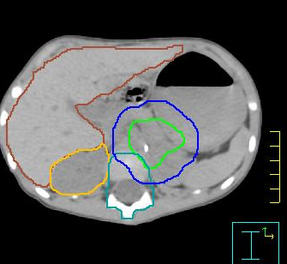
Target Volumes and organs at risk
Margins
CTV = GTV + 0,5
( +1 in LINES with avoidances)
PTV = CTV + 0,5-1cm
depending on age,location,contention
Organs at risk
  Vertebras
  Abdominal organs
  Liver, kidney(s), Spleen, Pancreas, small bowel
  Thoracic organs
  lung, heart
  Pelvic organs
  bladder, rectum, bones, ovaries, testicles

Slide 18
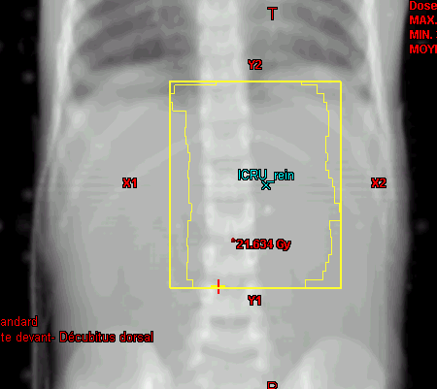
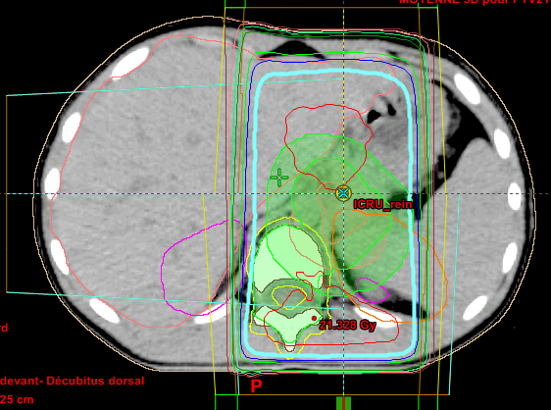
Radiotherapy in SIOPEN HR NBL 1.5
Dose
  21 GY / 1,5 GY
  14 fractions
  21 days maximum
PRV vertebras = Vertebras + 3mm
kidney
  Median constraint dose 15 Gy
  OK 21 Gy if remaining kidney is not irradiated
  PRV around remaining kidney
AP-PA or slightly obliques
Repositioning with Kv/KV is fine

Slide 19
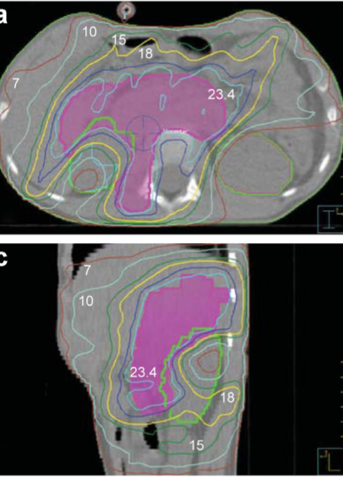
IMRT/VMAT for neuroblastoma ?
  Advantages
    Better conformality
    best method of RT delivery in midline tumors with respect to kidney doses,
But
  at a cost of a higher mean dose to the liver, stomach, spleen
  Always compare with standard RT
  Don’t forget the rules on vertebras and bones :
    contour vertebras in field and outside of field
    prescribe constraints in field and out of field
    be very careful.
  Theoretically increase of risk of second cancers
Panandiker et al, 2012
IMRT was not found to be better than the conventional AP/PA field for lateralized tumors.
Paulino et al. Pediatric Blood Cancer 2006
Plowman et al. Pediatric Blood Cancer 2007

Slide 20
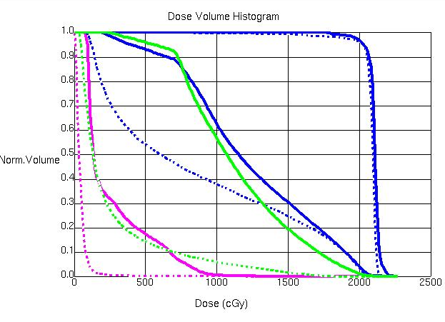
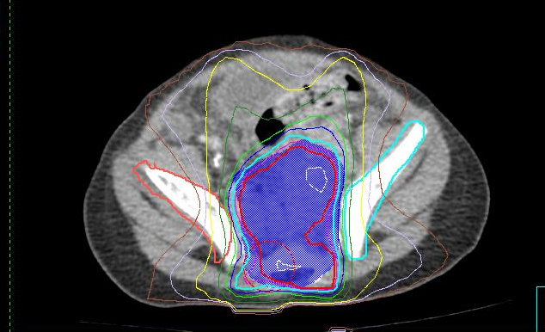
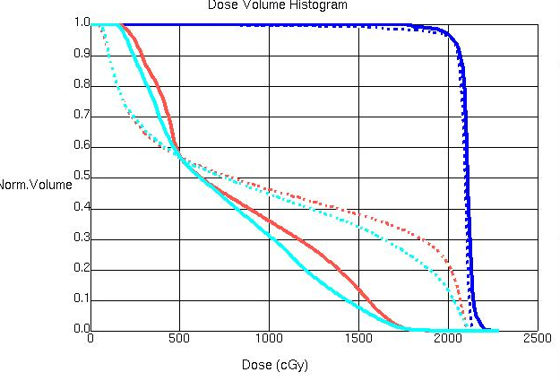
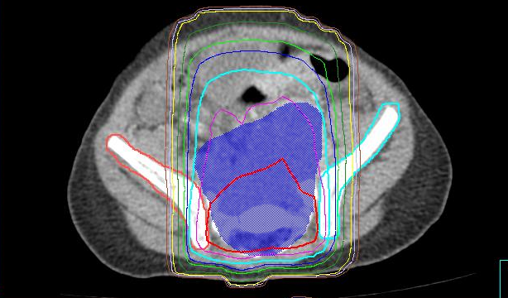
Comparison 3D ---versus IMRT
PTV
Right kidney
Left kidney
liver
PTV
Iliac bones

Slide 21
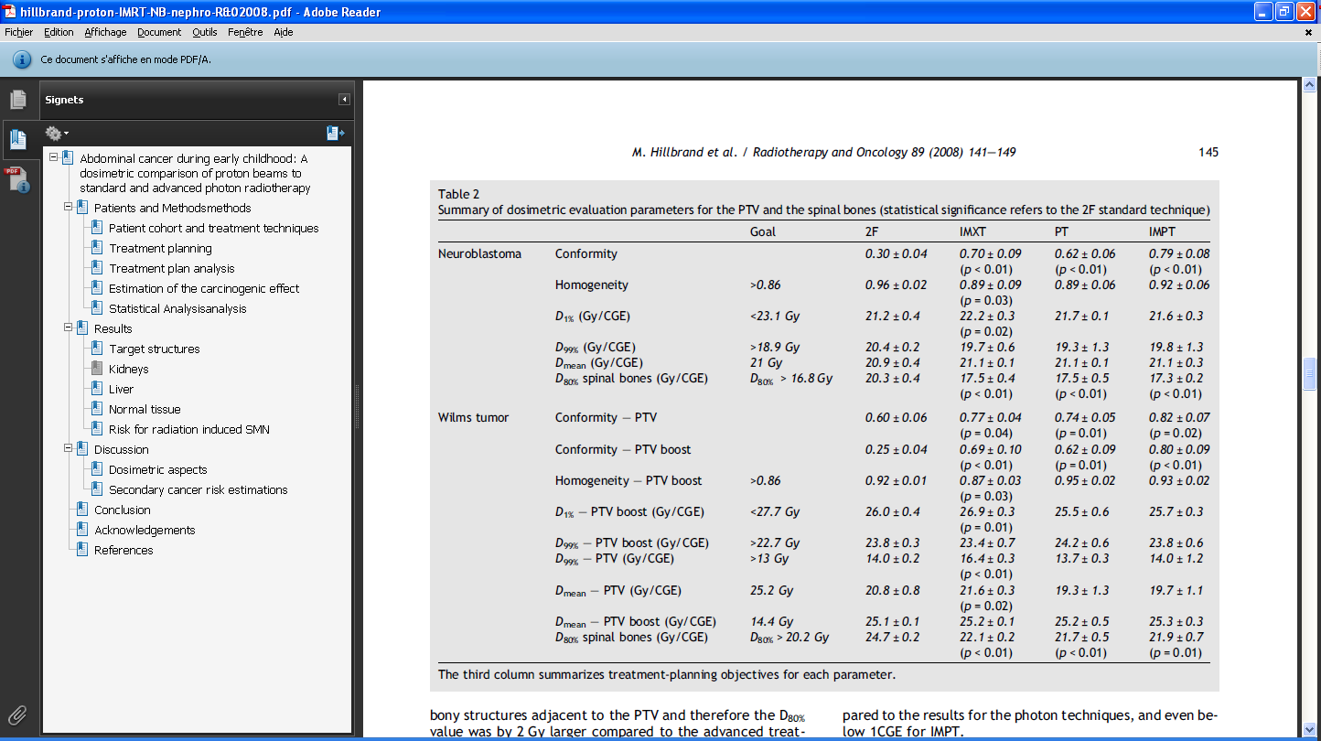
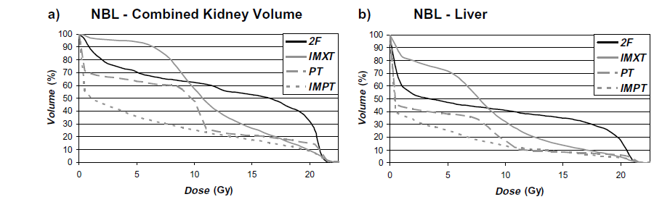
Comparison APPA-IMRT-PT-IMPT

Slide 22
Long term effects
Main potential late effects ?
  Musculoskeletal
  Metabolic syndrome
  Renal failure
  Fertility
  Second cancers

Slide 23
Limits of doses to OAR for neuroblastoma
Organ | Dose | complications
Ovaries | 2-5 Gy | Ovarian failure
Uterine | 2-5 Gy | Uterine dysfunction
Bone and muscles | 10-20 Gy | Bone and muscular hypoplasia
Bladder | 30 gy/ 45 Gy | Hemorragic cystitis/fibrosis
Vagina, uterthra | 40 Gy | stenosis
bowel | 50 – 55 Gy | Bowel obstruction
Rectum | 60 Gy | proctitis
Bone | 60 Gy | Osteonecrosis, fracture
Paulino, SIOP 2016

Slide 24
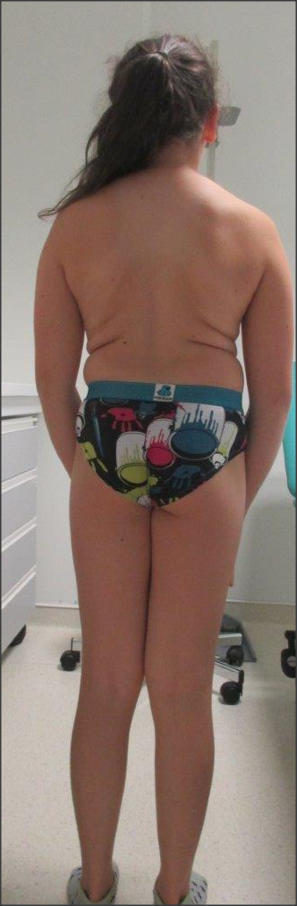
Vertebras
models to predict height
        Krasin et al IJROBP 2005
The height of children with neuroblastoma is significantly affected by RT.
  Depending on the number of irradiated vertebrae ( >6)
  The use of TBI
  changes in both signal and shape on MRI.
      Hua et al, IJROBP 2007
      Hartley et al, IJROBP 2008
      Yu et al, radiotherapy and oncology
Treated at 4 for stage 4
21 Gy
10 vertebras treated
Now 14, heighth -3DS

Slide 25
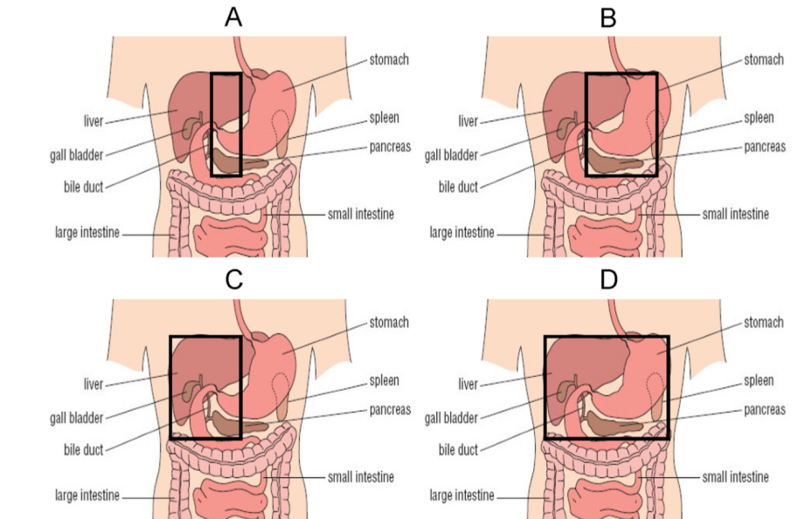
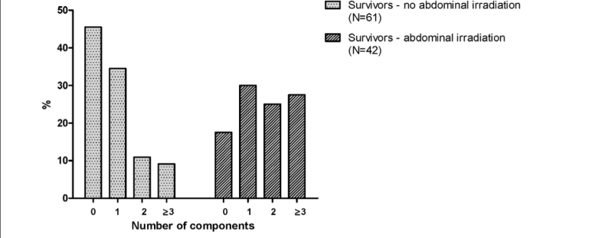
Metabolic syndrome
Survivors treated for neuroblastoma and nephroblastoma (n=67) were compared with controls ( n=61)
26 years follow -up
Components : Higher blood pressure, triglycerides, LDL-C, free fatty acids
Total percentage fat instead of Lower waist circumference as not reliable as can be decreased due to RT
Three times more frequent if abdominal RT ( 27%) versus none (9%)
Van Waas PlosOne2012

Slide 26
Long term sequelae
Stage IV :
  31 patients : « More than 50% of children with stage 4 NB may survive.
  high incidence of severe long-term sequelae 98% ».
Perwein et al, Pediatr Blood Cancer 2011
  153 patients Only 34% of patients with stage IV NB survived.
  44% of survivors experienced late morbidity .
Escobar et al, JPEd Surg 2006
Localized high risk
  Very few results as they are usually mixed with stage IV.
  35 patients : 73% toxicity - 45 % within RT fields , long follow up : median 14 years
  Ducassou et al, 2015, Strahlen Onkol

Slide 27

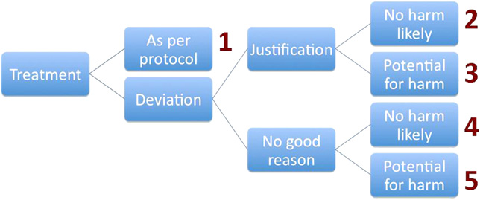
Centralised quality control of radiotherapy planning
882 patients in the database
100 files could be analysed
48 treatments as per protocol
29 Justified deviations without potential harm
5 justified deviations with potential harm
17 unjustified deviations with potential harm
impact on survival and sequelaes ?
Gaze et al, IJROBP 2012

Slide 28
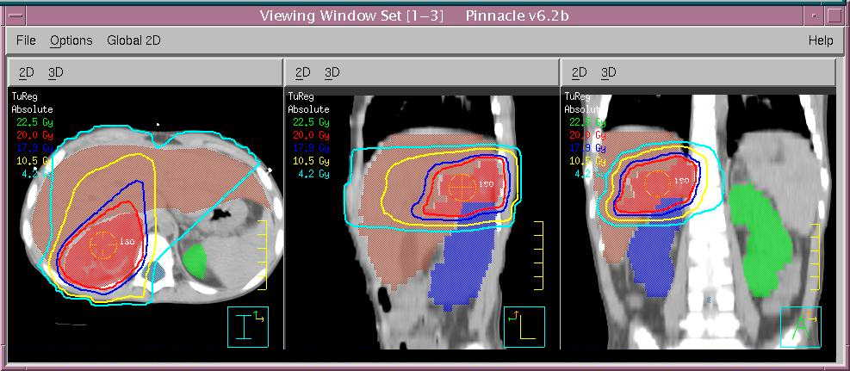
Centralised quality control of radiotherapy planning
Example of unjustified deviations
Risk of avoidable morbidity
  Irradiation of part of a vertebra
  CTV not extended to cover full vertebral width
Risk of failure of disease controle
  failure to cover involved lymph nodes

Slide 29
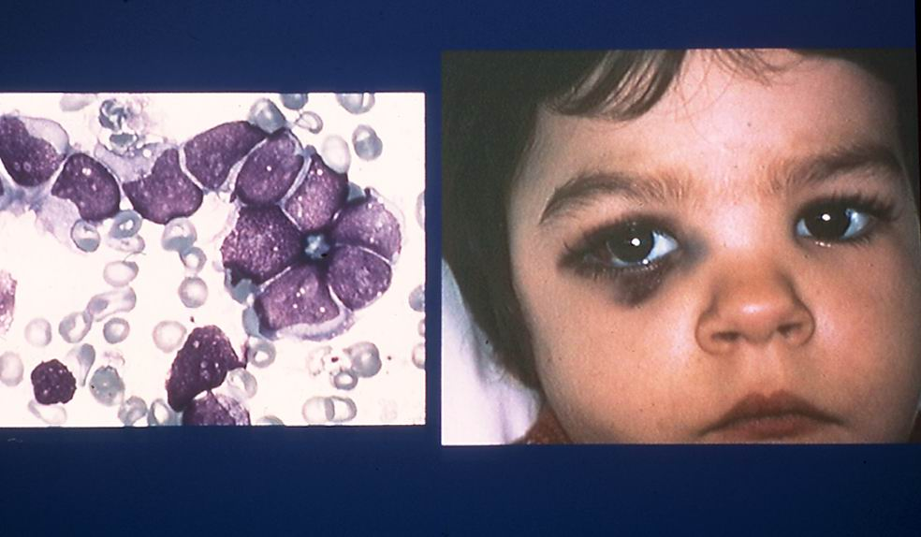
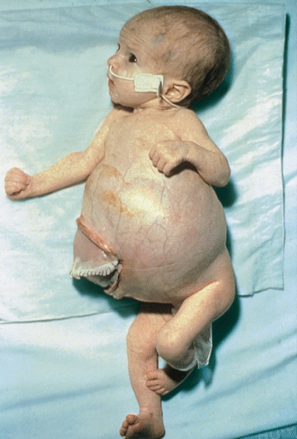
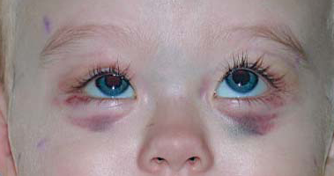
Place of RT in metastatic neuroblastoma
Hutchinson
Pepper syndrome

Slide 30
Indications
As symptomatic treatment :
  Pain
  Compression
  Esthetic
  Short duration : 12 to 20 gy /5 fr or 23 gy /1,8gy/fr
  Or as an integrated global strategy

Slide 31
Issues with Application of
Metastatic Site RT?
Currently
  Persistently MIBG-Avid lesions post induction or residual soft tissue disease
Future
  All neuroendocrine cells with active NE transporter
  Active NB with active NE transporter
  Persistently MIBG-Avid lesions post induction
  Residual soft tissue disease

Slide 32
NEXT EUROPEAN PROTOCOL
Possible (randomised) radiotherapy questions
Determining the need for RT post complete resection
Determining the benefit of dose escalation for residual disease
? The role for RT in oligometastatic disease
Prospective RTQA with Quartet

